Slide 1
International Workshop Enabling Successful Self-Regulation in Open Learning Environments S-ROLE 2012 http://dbis.rwth-aachen.de/S-ROLE2012/
Milos Kravcik (1), Alexander Nussbaumer (2), Carsten Ullrich (3)
(1) RWTH Aachen University, Germany
(2) Graz University of Technology, Graz, Austria
(3) Shanghai Jiao Tong University, China
ICALT 2012 in Rome, Italy
6 July 2012

Slide 2
Workshop Overview
Introduction [5 min]
ROLE project and workshop objectives
8 Presentations (10 min + 5 min for questions) [120 min]
key questions should be raised
Group work on the key questions [20 min]
discussion of assigned key questions
Short summary or group work [5 min]
one slide presentation with the main outcomes of the group discussion

Slide 3
Aims and Objectives
Discussing the concept of self-regulated learning (SRL) in the context of personal learning environments (PLEs)
Answering some key questions of SRL in PLEs
the discussions of the presentations and
the group discussions
Outcome should be new insights how SRL can be supported in PLEs

Slide 4
Key Questions
What are the barriers of SRL and how to overcome them?
How to facilitate user adoption of SRL?
How to support SRL properly?
How should (personal) learning environments foster SRL?
What is the relationship between learning objectives and SRL?
What are the metrics for success and effectiveness of SRL?
=> Short review of each presentation regarding these key questions

Slide 5
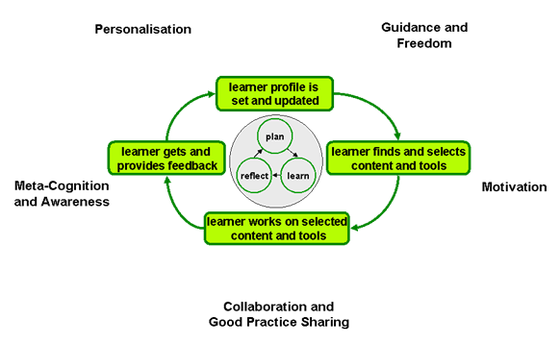
Self-Regulated Learning in ROLE
ROLE Psycho-Pedagogical Integration Model

Slide 6
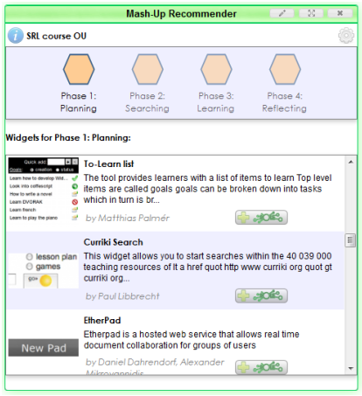
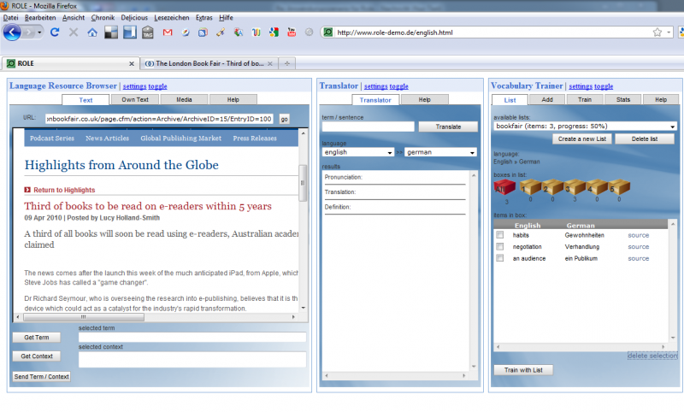
Personal Learning Environment
ROLE Approach – based on widgets
building personal learning environent
suitable for SRL

Slide 7
ROLE Project
http://www.role-project.eu
http://www.role-widgetstore.eu

Slide 8
Presentations
A Survey into the Teacher's Perception of Self-Regulated Learning Alexander Mikroyannidis, Teresa Connolly and Effie Law
Exploring the personal and self-directed use of weblogs Terje Väljataga and Sebastian Fiedler
Augmenting Simulated Environments by Services for Self-regulated Learning Support Marcel Berthold, Christina M. Steiner and Dietrich Albert
Introducing Learning Performance in Personal Learning Environments Laurent Moccozet
Recommending Learning Activities as Strategy for enabling Self-regulated Learning Pablo Lachmann and Andreas Kiefel
Self-Regulated Learning in a Mobile Health Initiative for Diabetic Patients Salys Sultan and Permanand Mohan
SRL Tasks and Activities as a Model of Cognitive Behaviour within ETTHOS Adam Moore, Victoria Macarthur and Owen Conlan
Supporting Self-Regulation by Personal Learning Environments Milos Kravcik and Ralf Klamma

Slide 9
Group Discussions
Group 1 (Alex)
What are the barriers of SRL and how to overcome them?
How to facilitate user adoption of SRL?
Group 2 (Milos)
How to support SRL properly?
How should (personal) learning environments foster SRL?
Group 3 (Marcel)
What is the relationship between learning objectives and SRL?
What are the metrics for success and effectiveness of SRL?

