Slide 1
Supporting Self-Regulation by Personal Learning Environments
Milos Kravcik, Ralf Klamma
RWTH Aachen University Advanced Community Information Systems (ACIS)
{kravcik, klamma}@dbis.rwth-aachen.de

Slide 2
Agenda
Self-Regulated Learning
Personal Learning Environment
Psychology & Neuroscience
JTEL Summer School Survey
JTEL Summer School Workshop
Conclusion

Slide 3
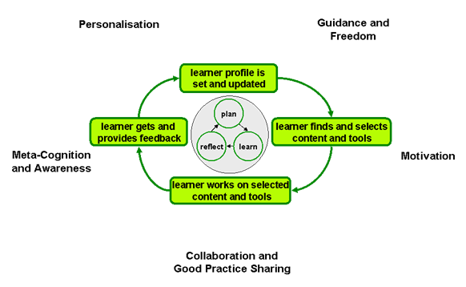
Self-Regulated Learning
ROLE Psycho-Pedagogical Integration Model

Slide 4
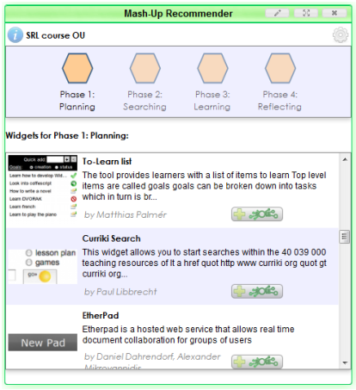
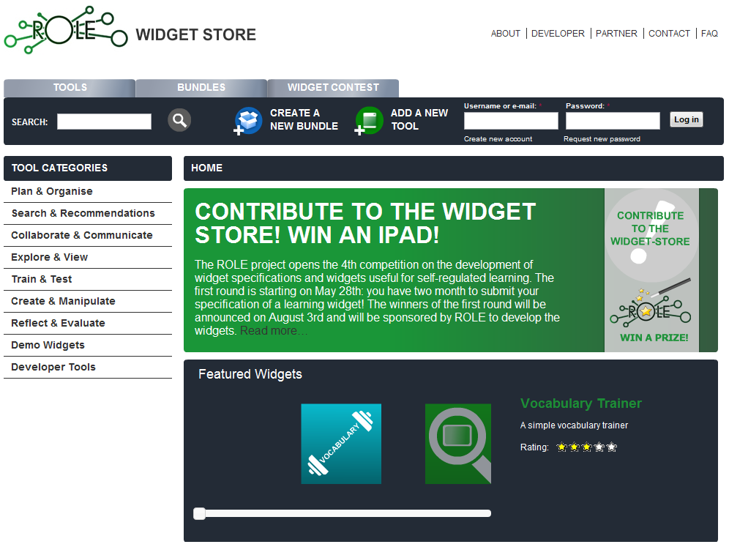
Personal Learning Environment
Aim: Learner can design & compose PLE according to personal preferences & context demands
ROLE Approach – based on widgets

Slide 5
Psychology & Neuroscience
Power of agency – motivation:
We have to be the ones making the decision in order to value it more after committing to it [Sharot 2011]
Self-regulatory competences – early recognition:
Self-imposed delay-of-gratification in preschool
High impact on successful learning later on [Shoda 1990]
Self-imposed deadlines
Not as effective as externally imposed ones [Ariely 2002]
Possible explanation – suboptimal self-imposed plans compared to the one given by the teacher

Slide 6
JTEL Summer School Survey
Conducted in June 2010
31 participants (mostly PhD students)
Statements on issues related to SRL
Freedom of learner
Pedagogical support
Necessity of tutors (teachers)
5 point Likert Scale
Outcome:
Not easy to identify real opinions/preferences of people
Choice architecture can influence them essentially

Slide 7
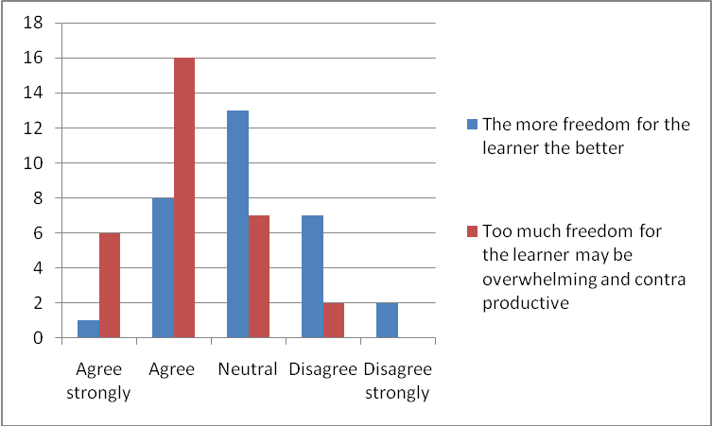
Freedom of Learner

Slide 8
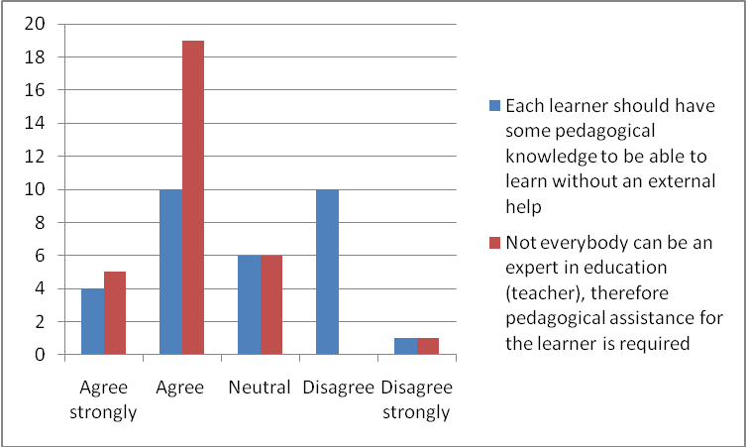
Pedagogical Support

Slide 9
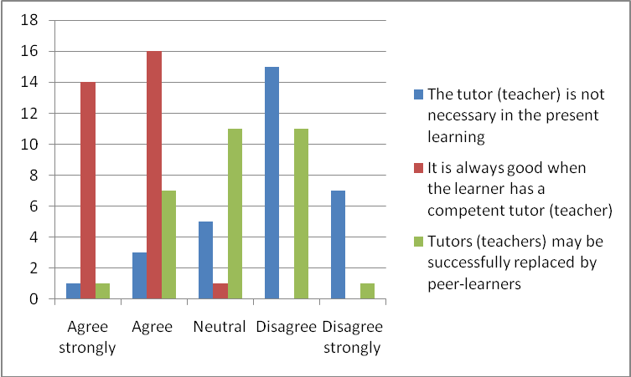
Necessity of Tutors

Slide 10
JTEL Summer School Workshop
May 2011: Psychology-informed Design, Usage & Development of Responsive Open (Personal) Learning Environments
Lecture: cognitive biases, choice architecture
Hands-on session: PLE assembling and use
3 groups of 5-6 people + tutor
Task: paper prototype (services, mockup), PLE (ROLE Widget Store, iGoogle)
Outcome: pedagogical benefits of the ROLE Widget Store are crucial compared to alternative solutions

Slide 11
Conclusion
Question: How can PLE support SRL?
Freedom to design & compose PLE according to current preferences & context –> Motivation
Issues:
Lack of SRL skills
Freedom can be overwhelming
Solutions:
Recommenders & searching based on pedagogical metadata
Suitable guidance from tutors
Continuous improvement of SRL skills
Challenge: Right balance between learner‘s freedom & guidance – individual, context-dependent

