Slide 1
Introducing Learning Performance in Personal Learning Environments
Laurent Moccozet
Institute of Services Science
University of Geneva
Switzerland

Slide 2
Learning Performance

Slide 3
Learning performance
A learning performance is the achievement of a learning activity
It includes two aspects:
  the result and
  the process.
Learning Environments focus on the result rather on the process.

Slide 4
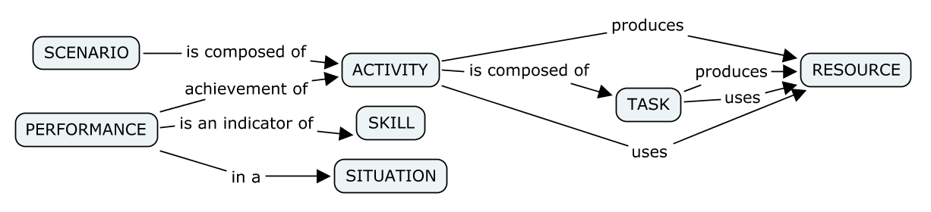
Learning performance
Based on “le glossaire du DISCAS” @ http://csrdn.qc.ca/discas/glossaire/FGlossaire.html, 2006

Slide 5
The performance process
Learning performance and self-regulated learning
  With the performance process (in addition to the performance result):
    Learners can recover HOW they performed a previous activity (to repeat it/improve it)
    Learners can reflect about HOW they performed an activity,
    Learners can learn/check/compare HOW peers have performed an activity,
    …

Slide 6
Personal Learning Environment

Slide 7
The PLE project
A federated institutional PLE enabler
  A swiss project for all universities
  Based on GRAASP (from REACT @ EPFL, Lausanne)
            ple.unige.ch
            graasp.unige.ch
            graasp.epfl.ch

Slide 8
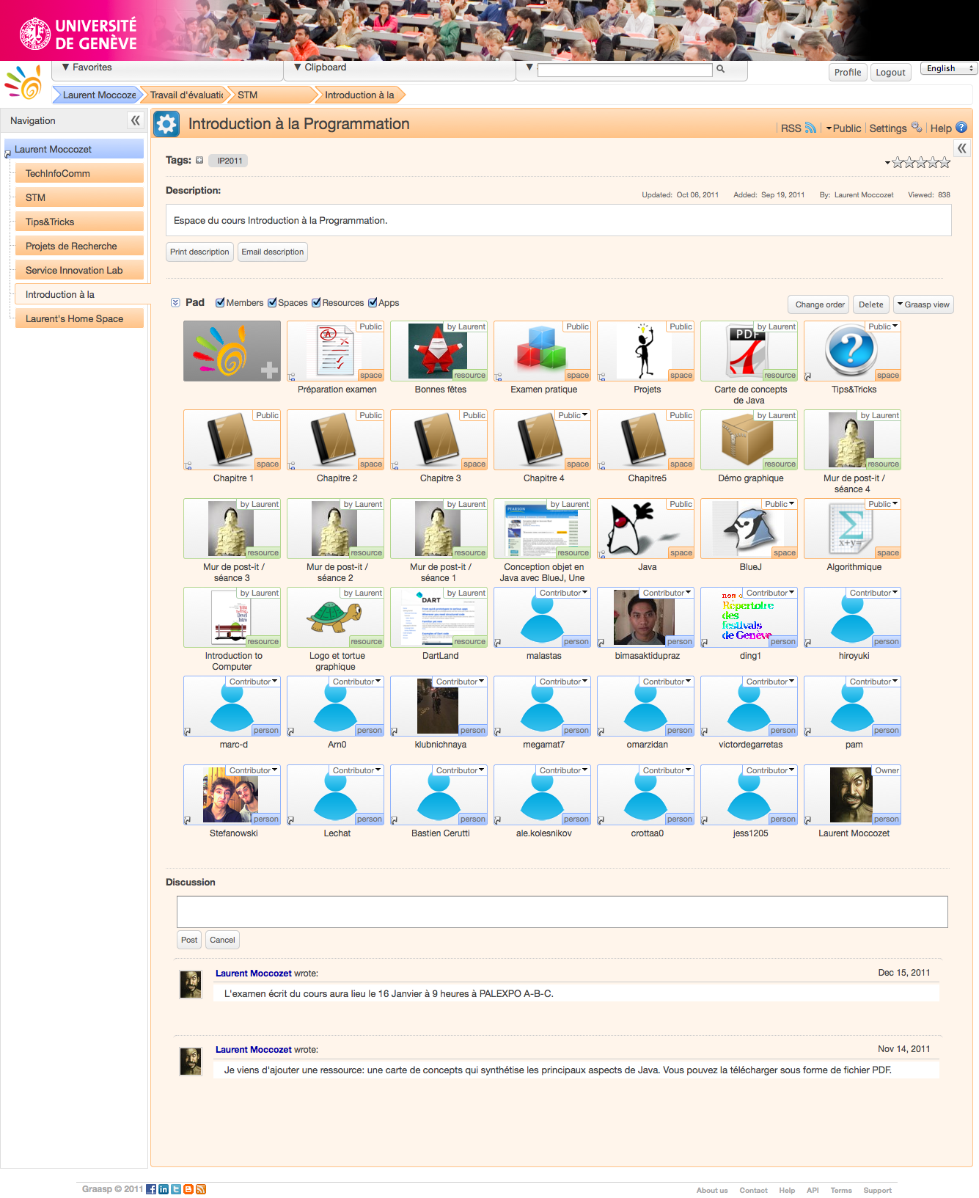
The PLE project
Pilot courses
  Bachelor/master
  Information systems/
  Business/Management/
  Communication
  From 6 to 140 students

Slide 9
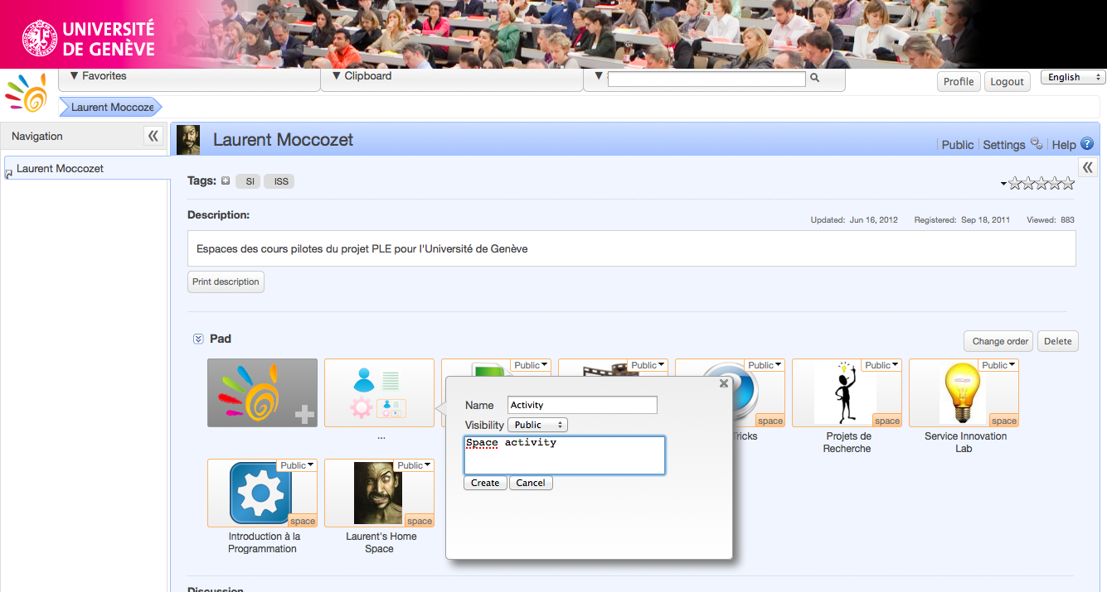
Learning activities in the PLE
The current process for managing learning activities
  The learner creates an activity (as a space)

Slide 10
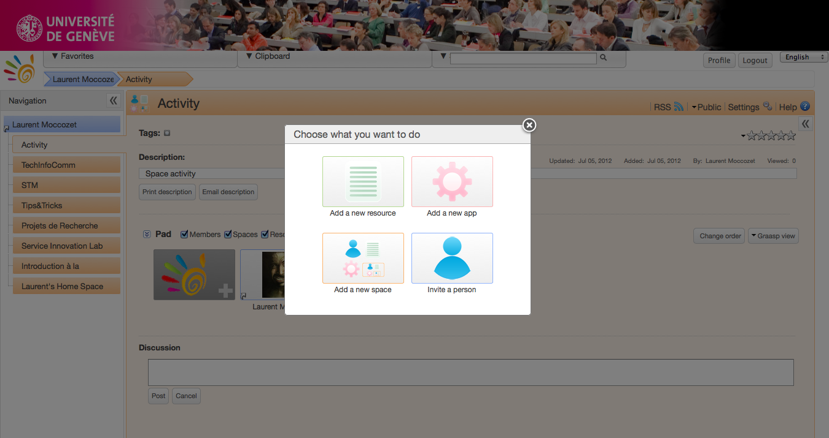
Learning activities in the PLE
The current process for managing learning activities
    Aggregates resources
    Aggregates tools (as widgets)
    Invites peer collaborators
    Then achieve the activity

Slide 11
Our proposal
How to introduce LP process in the PLE ?
  By logging space (activity) events (with timestamp) in a performance roadmap,
  By enabling learner to edit the performance roadmap (using a dedicated widget),
  By inserting the roadmap as a resource in the activity space
    Display it as a timeline

