Slide 1
SRL Tasks and Activities as a Model of Cognitive Behaviour within ETTHOS
Adam Moore, Victoria Macarthur, Owen Conlan
Trinity College, Dublin

Slide 2
SRL Tasks and Activities to Inform Metacognitive Scaffolding Provision
@adam__moore , @cufa , @oconlan
@imreal_project

Slide 3
Overview
Experiential Training Simulator
Metacognitive Scaffolding
Learner Activity Model
  Constructive Reading
  Diagnostic Interviews
  SRL?

Slide 4
Simulator

Slide 5
Scaffolding
Web service – NOT part of Simulator
Items from Schraw’s Metacognitive Awareness Inventory
Linked to activities in simulator during authoring by subject matter experts
Triggers during simulation display prompts to “reflect on your learning” – they are optional
Closed question and open free text area
Scaffolding free text sometimes has additional prompt from subject matter experts

Slide 6
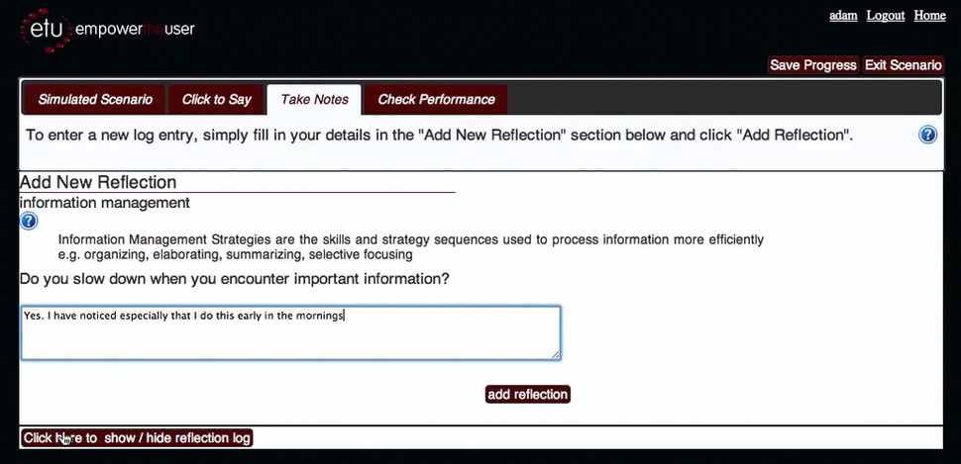
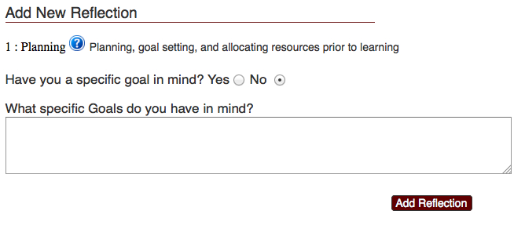
Scaffolding

Slide 7
Underlying Science
Learner Tasks -> Activities
Metacognitive Factors -> Items
Planning
Information Management
Comprehension
Debugging
Evaluation

Slide 8
Model
First: support for web-based e-Learning
constructive reading: Pressley & Afflerbach
Then: support for diagnostic interviews
Calgary Cambridge
BUT – specific / time consuming – opportunity!
support learning methodology?
SRL!

Slide 9
SRL-A-LRS

Slide 10
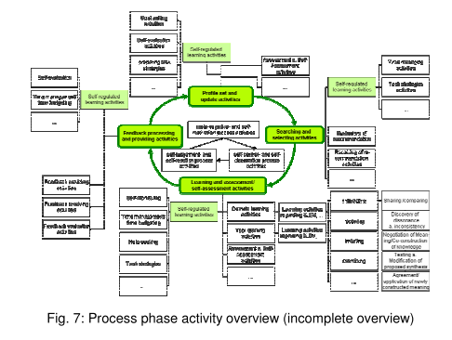
SRL Model?
ROLE D6.1!

Slide 11
Trajectory
Metacognitive scaffolding
  ETTHOS
    Macarthur, V., & Conlan, O. (2010). Modeling Higher-order Cognitive Skills in Technology Enhanced Distance Learning. 4th International Conference on Distance Learning and Education (ICDLE) (pp. 15-19).
  Moore, A., Conlan, O., Dagger, D., & Wade, V. (2011). Towards Non-invasive Adaptive Meta-Cognitive Support for Online Training. Poster Proceedings of the 11th IEEE International Conference on Advanced Learning Technologies. Atlanta, Georgia,USA.
Affective Monitoring
  Moore, A., & Ascolese, A. (2011). Explicit Tools for Affective Indicators. EC-TEL 2011 Workshop on Augmenting the Learning Experience with Collaborative Reflection. Palermo, Sicily, Italy.
Affective Metacognitive Scaffolding
  Moore, A., Macarthur, V., & Conlan, O. (2012). Core Aspects of Affective Metacognitive User Models. In L. Ardissono & T. Kuflik (Eds.), Advances in User Modeling: selected papers from UMAP 2011 workshops. Lecture Notes in Computer Science 7138 (pp. 47-59). Springer-Verlag GmbH. doi:10.1007/978-3-642-28509-7
Meta-Motivation???
  To create / maintain a positively valenced metacognitively scaffolded, motivated learning experience

Slide 12
Thank-you!
Adam Moore
KDEG, SCSS, Trinity College, Dublin
adam.moore@tcd.ie
@adam__moore / @imreal_project
http://www.imreal-project.eu
This work is funded by the EU FP7 Seventh Framework Programme Theme [ICT-2009.4.2], [Technology-enhanced learning]: ImREAL - Immersive Reflective Experience-based Adaptive Learning

